Slide 1



Antibiotic Drug Prescription Name: Alan Nieto
Team Member(s): Sean Iamartino Product Owner(s):Giri Narasimhan
Instructor: Masoud Sadjadi School of Computing and Information Sciences Florida International University
Senior Project Final Presentation
Summer 2016
08-05-2016
Notes:
7 seconds.
Greet your audience, thank them for attending your presentation, introduce yourself, introduce your project, introduce your team members, and quickly indicate what each of you did in a high-level manner, and put more emphasis on your part/contribution.

Slide 2
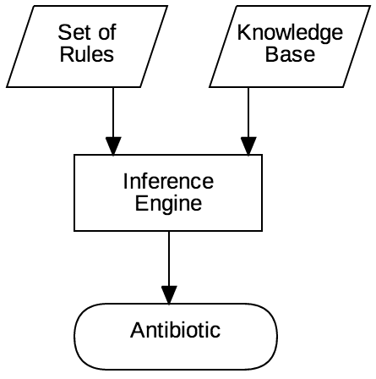
Project definition
Guide doctors to find the correct antibiotic for their patients
Accurate
Cross platform
Friendly UI/UX
Freeware
Notes:
10 seconds.
Introduce the problem that the whole project (in all versions) tackles with GIF or screenshot.

Slide 3
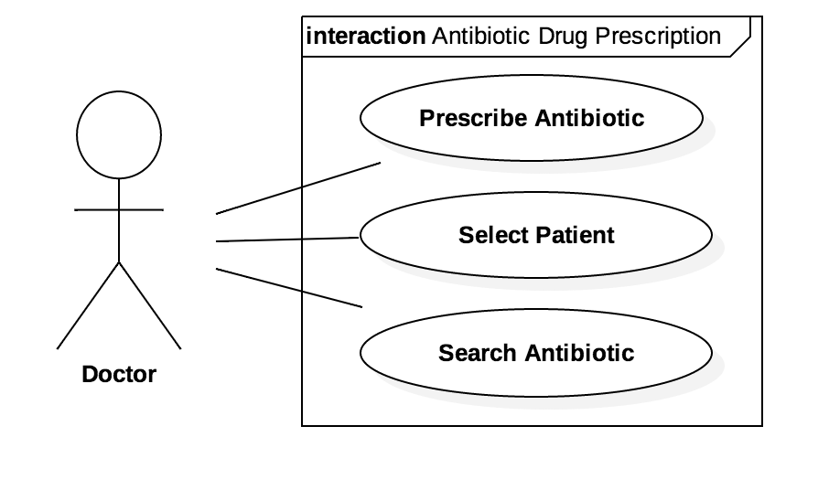
Requirements: Use Cases
Notes:
5 seconds
Show the Use Case Diagram for the whole project. Highlight your use cases.

Slide 4
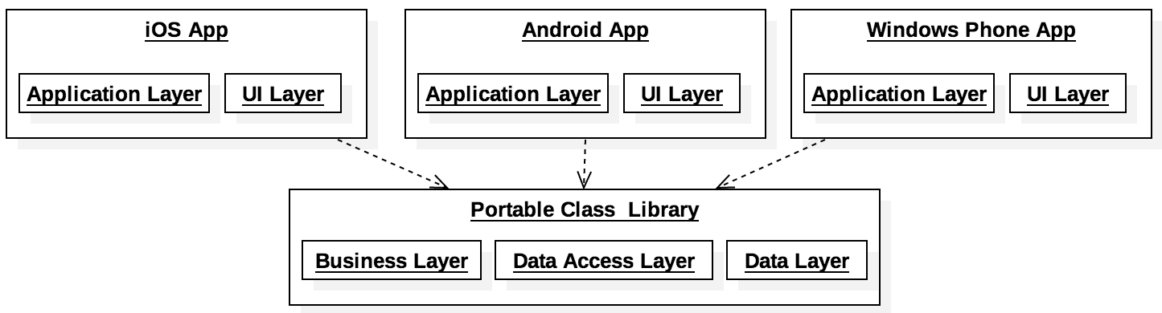
System Design: Architecture
Notes:
20 seconds
System design: Highlight the parts that you contributed to them.
1. System decomposition; identify the architecture patterns used
2. System deployment – h/w and s/w requirements

Slide 5
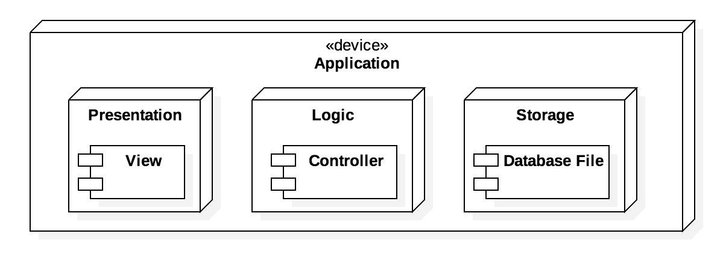
System Design: Deployment
Notes:
20 seconds
System design: Highlight the parts that you contributed to them.
1. System decomposition; identify the architecture patterns used
2. System deployment – h/w and s/w requirements

Slide 6
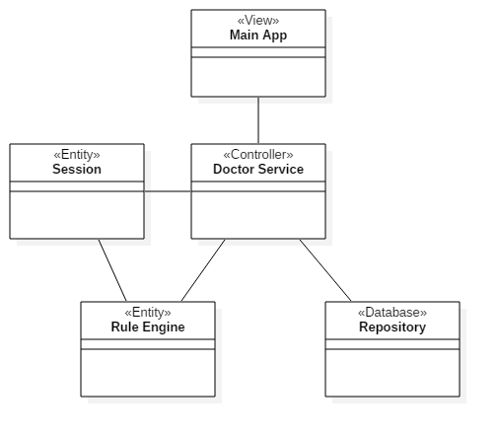
Minimal Class Diagram
Notes:
10 seconds.
Minimal class diagram. Highlight the classes that you created/modified
Identify the design patterns used (one or more slides).

Slide 7
User Stories
#711 Develop knowledge base
#663 Develop prescribe antibiotic
#667 Develop selected patient
#701 Improve Android UI/UX
#712 Create iOS UI/UX
Notes:
5 seconds.
List the user stories that you worked on them.(put in order of importance). Stay focused on the parts that you have been working.

Slide 8
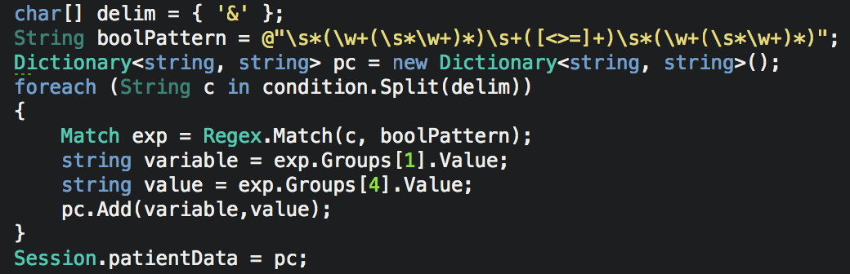
#711 Develop knowledge base
Transform base knowledge for inference engine
Regular expressions
Dictionary
Notes:
20 seconds
The tile of user story
Please present and show the complexity of your work, code, algorithms, and technical challenges and technologies you have used. (you could use screenshot if you want. Visual presentations are better than text presentation) - Go into the details of the most important/significant tasks using bullet lists or visual graphs or state chart diagram - Demo using screenshots or GIF (in another separate page if required)
Sequence Diagram for this user story is optional

Slide 9
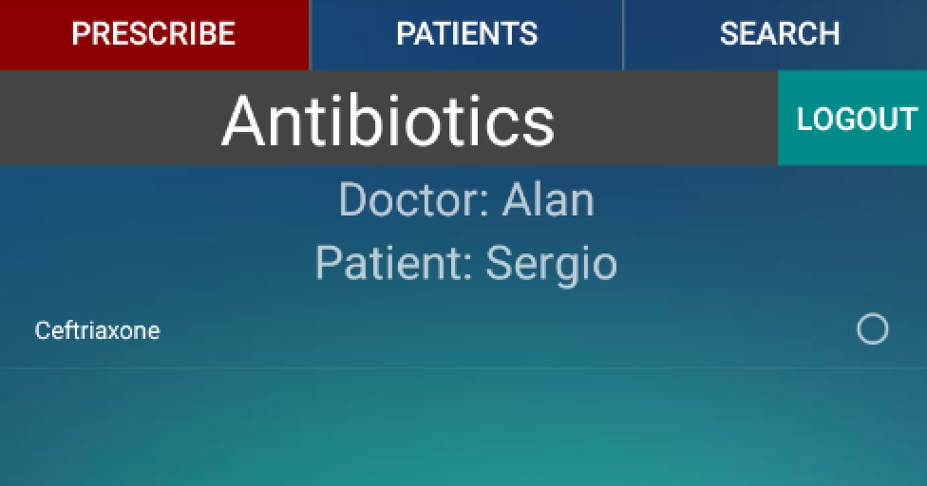
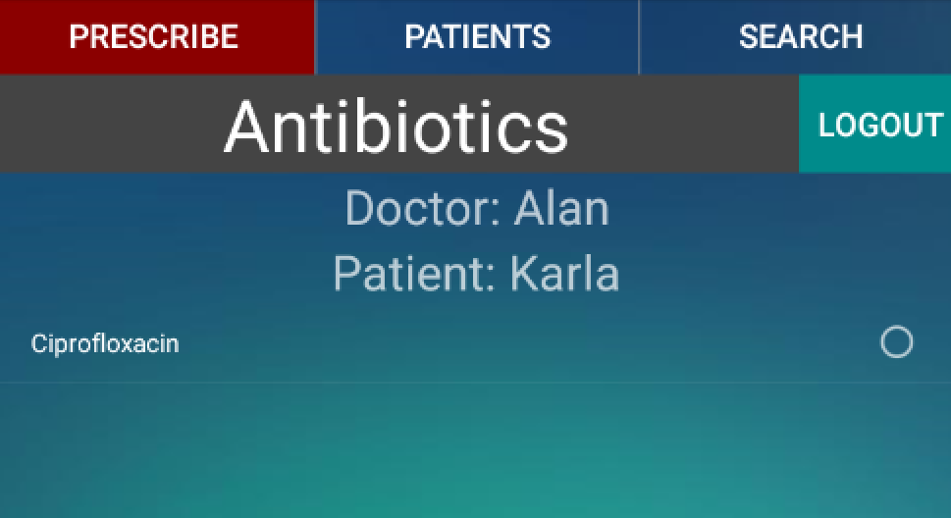
#711 Develop knowledge base
Notes:
20 seconds
The tile of user story
Please present and show the complexity of your work, code, algorithms, and technical challenges and technologies you have used. (you could use screenshot if you want. Visual presentations are better than text presentation) - Go into the details of the most important/significant tasks using bullet lists or visual graphs or state chart diagram - Demo using screenshots or GIF (in another separate page if required)
Sequence Diagram for this user story is optional

Slide 10
#663 Develop prescribe antibiotic
Base of the inference engine
Required input from doctor
Affected area
Type of infection
Notes:
20 seconds
The tile of user story
Please present and show the complexity of your work, code, algorithms, and technical challenges and technologies you have used. (you could use screenshot if you want. Visual presentations are better than text presentation) - Go into the details of the most important/significant tasks using bullet lists or visual graphs or state chart diagram - Demo using screenshots or GIF (in another separate page if required)
Sequence Diagram for this user story is optional

Slide 11
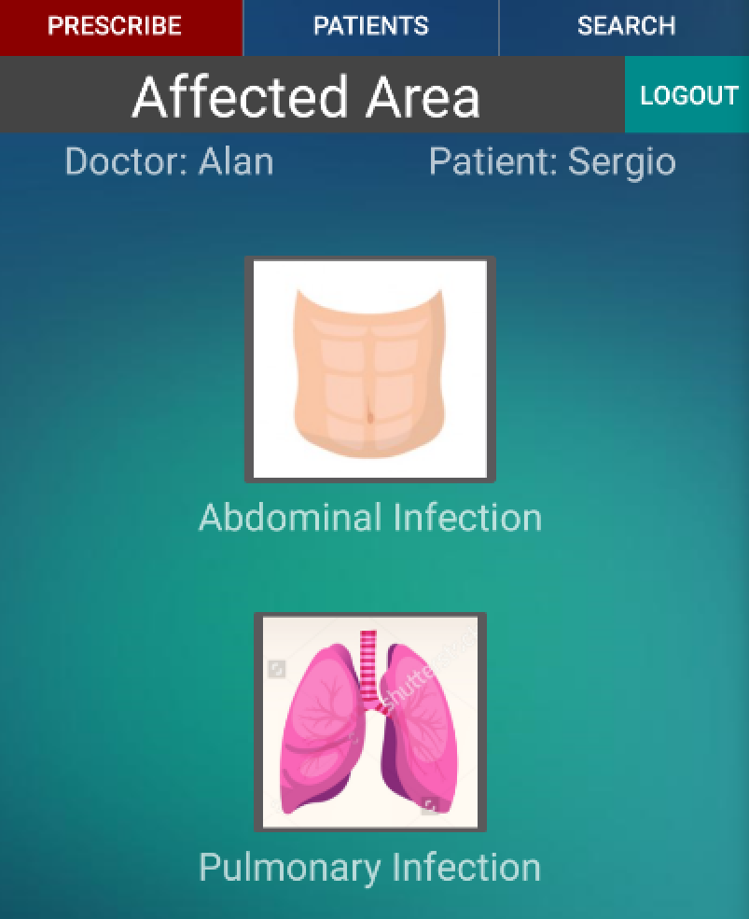
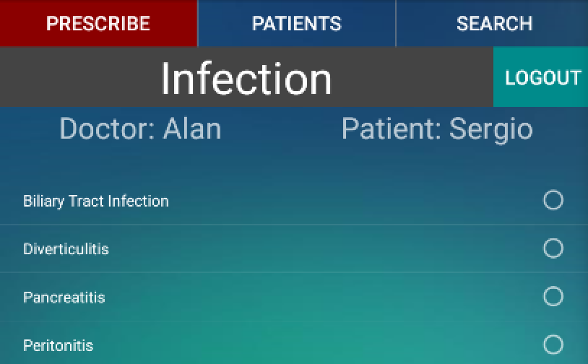
#663 Develop prescribe antibiotic
Notes:
20 seconds
The tile of user story
Please present and show the complexity of your work, code, algorithms, and technical challenges and technologies you have used. (you could use screenshot if you want. Visual presentations are better than text presentation) - Go into the details of the most important/significant tasks using bullet lists or visual graphs or state chart diagram - Demo using screenshots or GIF (in another separate page if required)
Sequence Diagram for this user story is optional

Slide 12
#667 Develop selected patient
Select patient
Display patient information
Required for inference engine
Notes:
20 seconds
The tile of user story
Please present and show the complexity of your work, code, algorithms, and technical challenges and technologies you have used. (you could use screenshot if you want. Visual presentations are better than text presentation) - Go into the details of the most important/significant tasks using bullet lists or visual graphs or state chart diagram - Demo using screenshots or GIF (in another separate page if required)
Sequence Diagram for this user story is optional

Slide 13
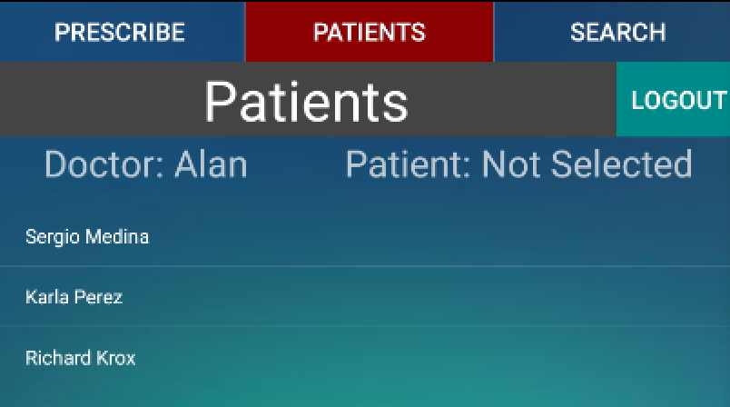
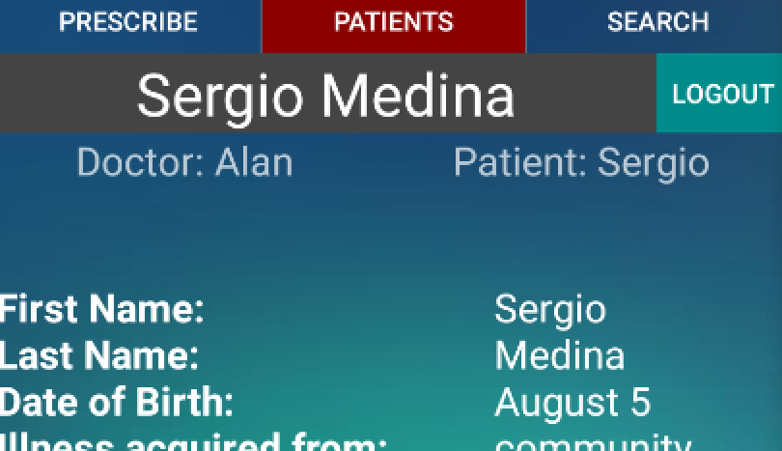
#667 Develop selected patient
Notes:
20 seconds
The tile of user story
Please present and show the complexity of your work, code, algorithms, and technical challenges and technologies you have used. (you could use screenshot if you want. Visual presentations are better than text presentation) - Go into the details of the most important/significant tasks using bullet lists or visual graphs or state chart diagram - Demo using screenshots or GIF (in another separate page if required)
Sequence Diagram for this user story is optional

Slide 14
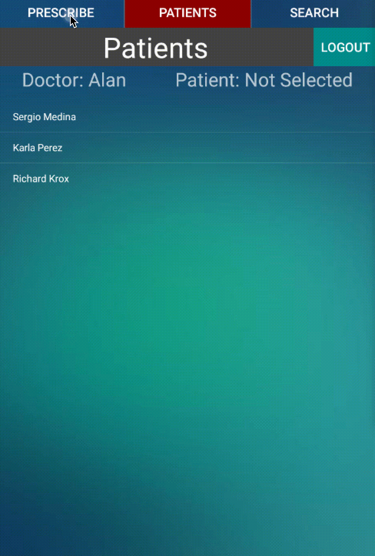
#701 Improve Android UI/UX
Notes:
20 seconds
The tile of user story
Please present and show the complexity of your work, code, algorithms, and technical challenges and technologies you have used. (you could use screenshot if you want. Visual presentations are better than text presentation) - Go into the details of the most important/significant tasks using bullet lists or visual graphs or state chart diagram - Demo using screenshots or GIF (in another separate page if required)
Sequence Diagram for this user story is optional

Slide 15
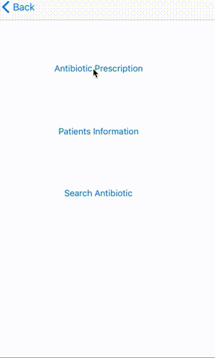
#712 Create iOS UI/UX
Notes:
20 seconds
The tile of user story
Please present and show the complexity of your work, code, algorithms, and technical challenges and technologies you have used. (you could use screenshot if you want. Visual presentations are better than text presentation) - Go into the details of the most important/significant tasks using bullet lists or visual graphs or state chart diagram - Demo using screenshots or GIF (in another separate page if required)
Sequence Diagram for this user story is optional

Slide 16
Sunny Test Case
Purpose | Rule engine return proper antibiotic
Precondition | Patient exists in the database
Input | · Area: “Abdominal” · Infection: “Biliary Tract” · Patient: “Sergio Medina”
Expected Result | Antibiotic Prescribed: “Ceftriaxone”
Notes:
10 seconds
A description of verification process and Test Suites and Test Cases for one of the use cases.
1 One sunny day and one rainy day for the implemented use cases (one or more slides).
2 Automated test scripts for the implemented use cases (if any) (one or more slides).

Slide 17
Rainy Test Case
Purpose | Rule engine alert doctor of missing information
Precondition | Patient exists in the database
Input | · Area: “Abdominal” · Infection: “Biliary Tract” · Patient: “Karla Abad”
Expected Result | Missing information: “PNC allergy”
Notes:
10 seconds
A description of verification process and Test Suites and Test Cases for one of the use cases.
1 One sunny day and one rainy day for the implemented use cases (one or more slides).
2 Automated test scripts for the implemented use cases (if any) (one or more slides).

Slide 18






Summary
Ability to change rules
Collected data
Automatically
Contact Information
Email: aniet009@fiu.edu
Skype ID: ANG360_
Questions?
Thank You!
Notes:
10 seconds
Summarize your contribution, mention your effort for Scrum, Mingle, Github, Google Drive Documentation and minutes
Include your contact information
Ask if anyone has any questions for you.
Thank your audience

